Slide 1
Project On Face Mask Recognition
By Monalisa Panda

Slide 2

Contents
Proposed Approach
Explanations
Live Demo of Face recognition
Deployment
End

Slide 3

Proposed Approach:-
Collection of Data
Split the Data Into Train and Test set
Build The Model
Train the Model
Results
Deploy The Model
Importing the Face Detection Program

Slide 4
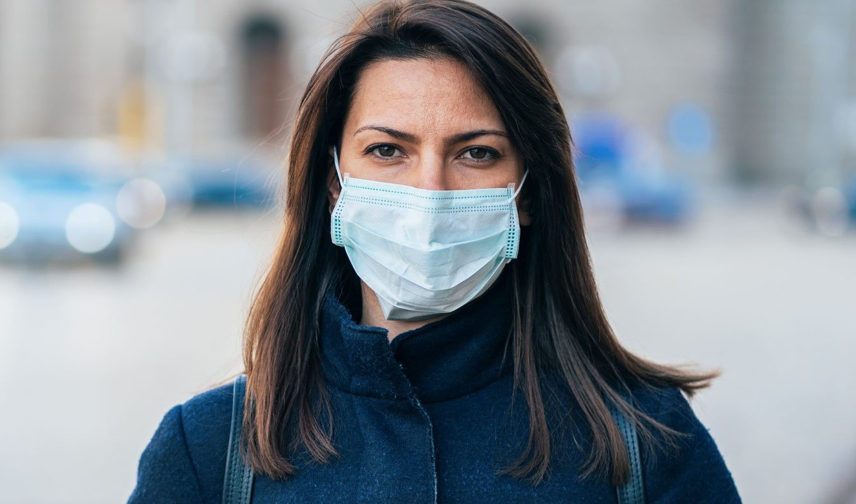
Project Overview:-
Classifier
Target Label
Mask
No Mask
Training Images
Testing Images

Slide 5
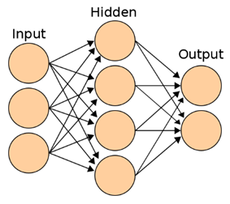

Project Overview (How it actually Works)
Flatten
Convolution
Pooling
Kernels
Pooling Filters
Results

Slide 6
Feature Detection/Extraction:-
0 | 1 | 1 | 0 | 1
1 | 0 | 0 | 0 | 1
1 | 1 | 0 | 0 | 0
0 | 1 | 1 | 1 | 0
0 | 0 | 1 | 0 | 1
1 | 0 | 0
0 | 1 | 0
0 | 1 | 0
1 | 1 | 1
3 | 1 | 1
2 | 3 | 1
http://setosa.io/ev/image-kernels/

Slide 7
RELU(Rectified Linear Units):-
RELU Layers are used to add non-linearity in the feature map.
It also enhances the sparsity or how scattered the feature map is.
The gradient of the RELU does not vanish as we increase x compared to the sigmoid function
1 | -2 | 0
7 | 10 | -3
-4 | 12 | 14
f(y)=y
1 | 0 | 0
7 | 10 | 0
0 | 12 | 14
f(y)=0

Slide 8
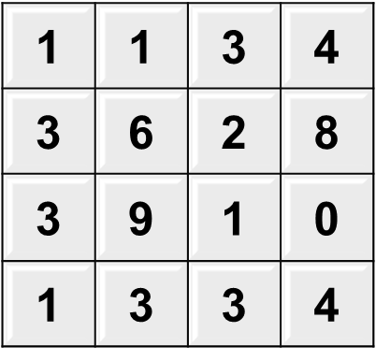
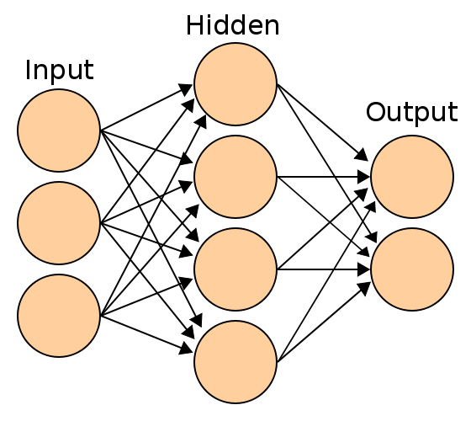
Max Pooling(Down Sampling):-
6
8
9
4
MAX POOLING
FLATTENING
6 | 8
9 | 4
Link: http://scs.ryerson.ca/~aharley/vis/conv/flat.html

Slide 9
MODEL DEPLOYMENT

Slide 10

Thank You By Monalisa Panda

